Slide 1
IRAD Update 15 Mar 23

Slide 2
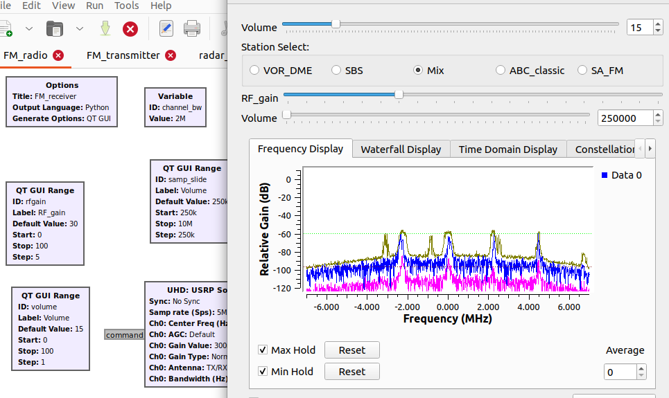
Recursive Receiver
This project is aimed to investigate the potential and applications of IIR filters in EW components.
Infrastructure
Item
USRP B210 (Radio)
Laptop
Antennas: Log Periodic / Monopole
Coaxial cables
GNU-radio software

Slide 3
Recursive Receiver
Personnel
Level | Name | LoE | Allocated hours | Spend hours | Spend time
Expert | Hugh Kennedy | 0.2 | 121.6 | 13 | 10.69%
Mid-level | Diego Lozano | 0.4 | 243.2 | 67.6 | 27.80%
Junior | Swapnil Srivastava | 0.6 | 364.8 | 111.5 | 30.56%
The allocated hours is based on the timeframe from 30 JAN 23 to 19 MAY 23 →(15 weeks 4 days)
Current: stage 2 – Phase 1
RF design and testing: basic digital filters, modulation/demodulation using the USRP & GNU-radio.
RF measurements, SNR, noise floor.
Reading and simulation of polyphase filter-bank (Multirate)
Implementation of a FMCW radar

Slide 4
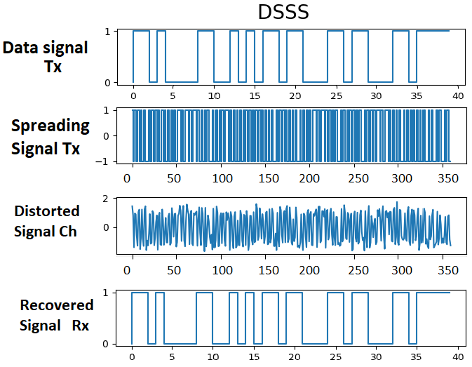
Differential LPI DSP
This project is aimed to investigate and create novel radio-techniques using machine learning. This can be accomplished by characterization transmission impairments and modeling of RF systems with auto-differentiable blocks that allow gradients to backpropagate from an objective function.
Infrastructure
Item
Desktop computer
Server
GitHub repository
Visual Studio Software
Python 3.10 programming language

Slide 5
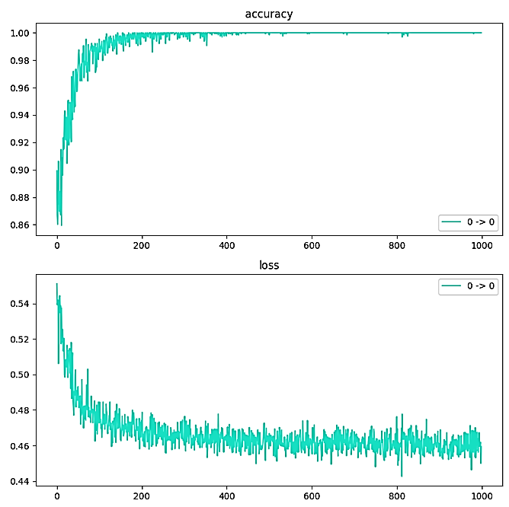
Differential LPI DSP
Personnel
Level | Name | LoE | Allocated hours | Spend hours | Spend time
Expert | Daniel Gibbons | 0.2 | 182.4 | 17.8 | 9.76%
Mid-level | Diego Lozano | 0.4 | 273.6 | 60.0 | 21.93%
Junior | Tim Kral | 0.6 | 258 | 0 | 100.00%
The allocated hours is based on the timeframe from 06 FEB 23 to 30 JUN 23 →(20 weeks 4 days)
Current: Establish DSSS baseline
Implement the Received and transmitter DSSS @ baseline
Simulate a simple transmission with AWGN
Optimize the receiver gain based on gradients to recover the transmitted message.
Add channel distortion effect

Slide 6
FPECM Power measurement
This project is aimed to provide automated characterization of transmitted RF energy in both angle of arrival and distance. It will then transfer the measured RF energy to usable polar plots.
Infrastructure
Item
Desktop computer
Robot
SDR: HackRF One
Antennas & LNA
Raspberry Pi
GNU-radio software

Slide 7
FPECM Power measurement
Personnel
Level | Name | LoE | Allocated hours | Spend hours | Spend time
Expert | Aaron Debono | Closed | 0.5 | Closed | Closed
Expert | Aaron Logue | 0.1 | 65.5 | 66 | 100.76%
Junior | Nicholas Paczynski | 0.6 | 693 | 636.1 | 91.79%
Junior | Sean Priestley | 0.6 | 72 | 31 | 43.06%
The allocated hours is based on the timeframe from 22 AUG 22 to 31 MARCH 23 →(31 weeks 4 days)
Current: Establish DSSS baseline
Implement the Received and transmitter DSSS @ baseline
Simulate a simple transmission with AWGN

Slide 8
FPECM Power measurement
Overview
The FPECM RF power measurement task has continued to move ahead with Nick making good progress over the last couple of weeks. This has been primarily on the distance robot which houses the receiver.
Personnel
Nicholas Paczynski – Will remain on task until 1 Feb 23 at close to 1 FTE (some hours assigned to upskilling for MMEW in Feb). At this stage Nick will be tasked at 0.5 FTE on MMEW. Nick could continue with the IRAD task to fill the 0.5 FTE remaining until other tasking is found for him. This has not been budgeted for.
Aaron Logue - I provided support up to and just after the Xmas break to enable Nick to progress at a faster rate and to provide guidance on development techniques. This included the use of additional hours (18) as requested at the pre-Xmas IRAD meeting.
Infrastructure
Most of the hardware has arrived with some small items outstanding. At this stage this can be worked around.

Slide 9
Recommendations
Improve the project traceability
Include systematic progression sub-tasks/Stages on mis or defined by project managers
Conduct a monthly/fortnightly review about the learned or required skills. Each team member can fill a questionary or writing 1 or 2 paragraphs about the learned or required skills.
Identify key skills needed for a particular task.
They can have benefits in the short term.
Offer diverse perspective about stage of the project
Improve the project documentation
Create a template document with defined sections such as the abstract, background information, process & methods and findings.
It can be a dynamic document that can be continually edited and updated by all-project members.

Slide 10
Recommendations
Improve the workshop installation
Get shelf or organizer for tools and equipment
Include systematic progression sub-tasks/Stages
Conduct a monthly/fortnightly review about the learned or required skills. Each team member can fill a questionary or writing 1 or 2 paragraphs about the learned or required skills.
Identify key skills as they can have benefits in the short term.
Offer diverse perspective about stage of the project
Improve the project documentation
Create a template document with defined sections such as the abstract, background information, process & methods and findings.
It can be a dynamic document that can be continually edited and updated by all-project members.

Slide 11
Conduct research and development
Systematic progression of work
Conduct a literature review
Find the gap (Knowledge/ technology)
Formulate a Hypothesis
Design experiments
Analyse experiment results
Logical conclusions

Slide 12
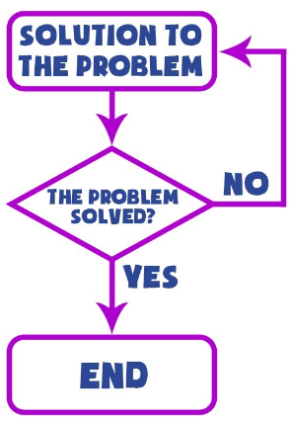
Conduct research and development
Trial and Error method
Advantages | Disadvantages
Effective for short term tasks | Time consuming
A good learning method | Waste of resources
Simplest applications | Unpredictable
 | Brute force

Slide 13
Conduct research and development
Systematic progression of work
Conduct a literature review
Find the gap (Knowledge/ technology)
Formulate a Hypothesis
Design experiments
Analyse experiment results
Logical conclusions

Slide 14
Advantages
R&D Tax Incentive supported
Supported by the Australian government
Tax offset rates depends on the company aggregated turnover (Thr= $ 20 Million)
Meet the criteria

